Slide 1
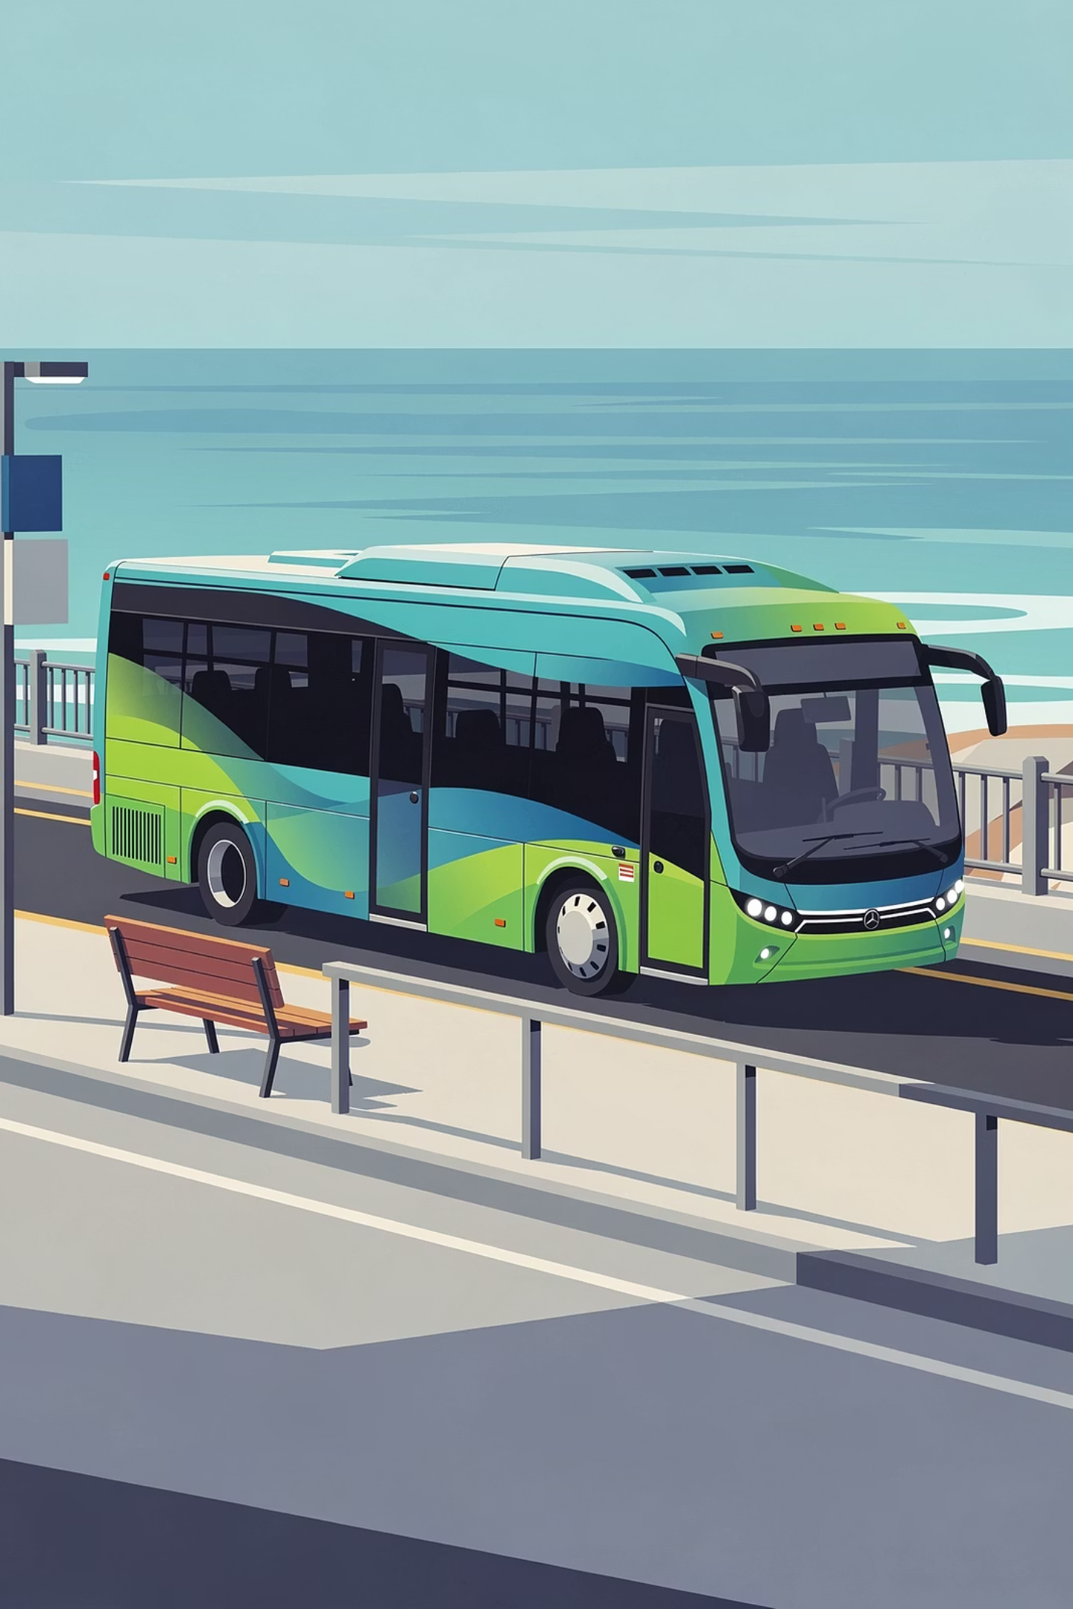
BSOOB Transit: FY 2027 Budget Presentation
Old Orchard Beach Town Council · Fiscal Year 2027
7-MINUTE BRIEFING

Slide 2

FY 2026 Year in Review
BSOOB Transit: A Year of Connection & Growth
Before looking ahead to FY 2027, here's where we stand — a system delivering real results for the Biddeford Saco Old Orchard Beach region.
285K+
25,000+
Passenger Trips
Revenue Hours
Projected to exceed 285,000 trips in FY 2026 based on current ridership trends.
Scheduled revenue service hours successfully delivered across the tri-city area.
30+
7
Local Partnerships
Essential Routes
Contracted stops and advertising partnerships with Saco and Old Orchard Beach businesses including MaineHealth Sun Outdoors, Jimmy the Greeks, and Ready Seafood.
Route 60 (Portland) and the Old Orchard Beach Trolleys remain the backbone of the regional workforce and seasonal economy.
These results reflect a system that works — and a community that depends on it. FY 2027 investments are designed to build on this momentum.

Slide 3
What We'll Cover
A Budget Built Around Your Community
FY 2027 focuses on the Seasonal Trolley service that is central to Old Orchard Beach's economy, a new equitable pricing structure for campground partners, leveraging federal dollars, and maintaining near-balanced operations.
01
02
Budget Overview
Seasonal Trolley Service
FY 2026 vs. FY 2027 at a glance
94,000 rides and growing
03
04
Return to Full Fixed Route Service
Revenue & Expense Drivers
Brining back frequency and improving routes for better
functionality
How we keep local costs in check

Slide 4
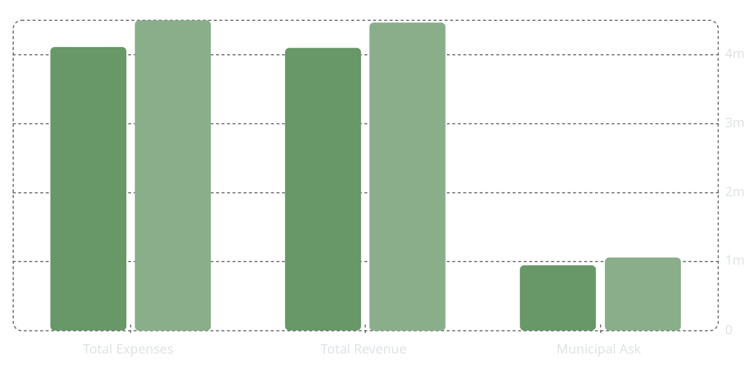
Budget Overview
FY 2026 vs. FY 2027: By the Numbers
FY 2026
FY 2027
Key Takeaways
4.5m
4.47m
4.11m
4.1m
9.4% Expense Growth
Total operating expenses rise to $4,499,481 — driven primarily by labor investment.
945k
1.06m
Near-Balanced Operations
Revenue of $4,466,510 keeps the system financially sound.
12% Municipal Increase
Combined ask from Biddeford, Saco, and Old Orchard Beach $352,800 each for a total of $1,058,400.

Slide 5


Operating Expense Drivers
Fuel & Energy: From Diesel Volatility to Electric Stability
Energy costs tell a story of transition. FY 2027 reflects both the ongoing reality of diesel dependence and the first meaningful steps toward a more predictable, locally-managed electric future.
Diesel Budget: $253,977
EV Charging: $29,589
Budgeted at an average of $3.92/gallon. Diesel remains our largest energy line item — but not for long.
A brand-new dedicated line item in FY 2027, reflecting real fleet modernization in progress. We anticipate delivery of two additional battery electric buses at the end of the year.
Why the Shift Matters
Electric costs are more predictable than diesel — insulating BSOOB from fuel market swings and long-term price volatility. The infrastructure powering this transition, including the Saco Transportation Center chargers, is funded almost entirely by external grants.
Every dollar shifted from diesel to electric charging is a win — as a fuel source we save approximately $0.36 per mile or 56% compared to diesel.
⚠️ Contract Risk: Our diesel fuel contract expires at the start of FY 2027 — coinciding with peak market uncertainty. This timing represents our highest point of energy cost exposure and underscores the urgency of accelerating the transition to predictable, locally-managed electric charging.

Slide 6

SEASONAL TROLLEY SERVICE
The Trolley That Moves Old Orchard Beach
The Old Orchard Beach Trolley is the backbone of the region's seasonal economy — connecting campgrounds, beaches, and businesses from Memorial Day through Labor Day. In FY 2026, the Trolley delivered 94,000 passenger trips, making it one of the highest-ridership seasonal transit services in Maine.
5 Trolley Routes
Memorial Day – Labor Day
4 core trolley runs operated every daily Camp Ellis Shuttle running Thursday–Sunday afternoons.
Full seasonal service window connecting campgrounds, the beach, and downtown OOB.
30+ Campground & Business Partners
Contracted stops serving Sun Outdoors, Jimmy the Greeks, Ready Seafood, and more.

Slide 7

Service Improvements
Full-Service Returns — and Gets Even Better
The FY 2027 budget is designed to bring some relief to Old Orchard Beach riders — restoring full service on two key routes while expanding frequency on two key corridors.
Route 52 (White Line) — Full Service Restored and Improved
Route 53 (Blue Line) — Full Service Restored
Old Orchard Beach Schedule Improvements
Route 52 also returns to full service, with a modification to serve the Beach and the Pines on the inbound trips. The hope is that the improved frequency will make this route a more viable solution for residents.
Route 53 returns to full service in FY 2027, reconnecting Old Orchard Beach riders to the destinations and schedules they depend on. The Blue Line is a cornerstone of
Improved scheduling on Old Orchard Beach runs includes new hourly service on W. Grand Ave and Temple Street, including The Pines — giving riders more predictable, frequent connections to key destinations.
The return of full service on Routes 52 & 53, combined with route improvements represents a significant service expansion delivering real value for Old Orchard Beach's investment.

Slide 8
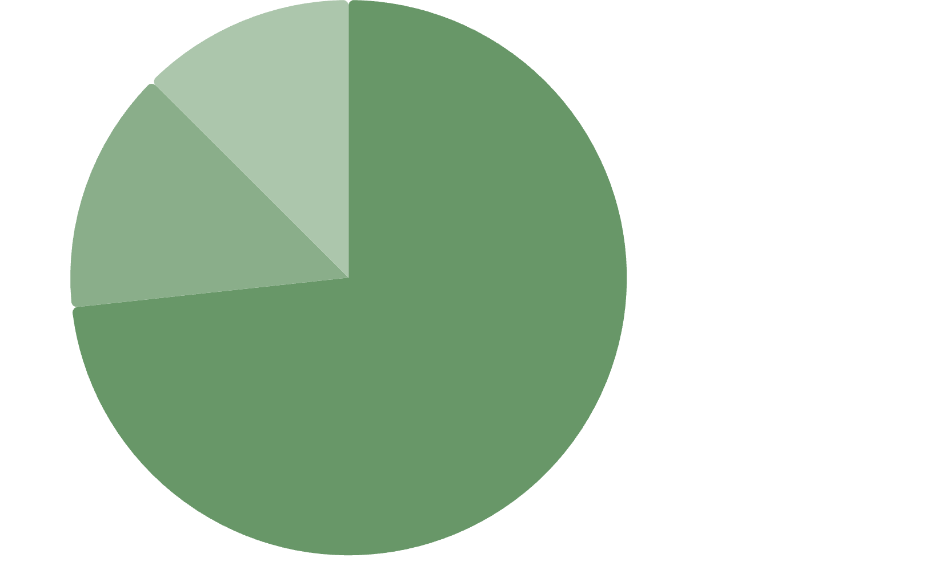

Operating Expense Drivers
Where the Money Goes
Labor Is Our Largest Investment
Wages & Benefits: $3,304,225 — representing 73% of total operating costs. This reflects both competitive driver and mechanic wages in today's hiring market and our commitment to reliable service.
Wages & Benefits·73.28%
·
Fuel & Utilities·14.21%
·
Other Operating·12.51%
·
Fuel & Utilities: $601,541 — diesel remains a major line item, but the fleet transition is underway.
FY 2027 marks the first year EV Charging Expense ($29,589) appears as a dedicated line — a sign of meaningful fleet modernization in progress.

Slide 9

Revenue Diversification
Local Dollars Work Harder Here
Grants Carry the Weight
Federal and State grants cover 57% of operations — $2,565,089 combined. For every local dollar contributed, BSOOB brings in nearly $3 in external support.
Federal Grants·40.3%
·
State Grants·17.13%
·
Fare Revenue·8.47%
·
Fare Revenue: $378,341 — strong recovery reflecting consistent, growing ridership
OOB Trolley Partners: Campground contracts and advertising partnerships — including Sun Outdoors, Jimmy the Greeks, and Ready Seafood — are a key driver of local revenue.
Municipal Contributions·23.7%
·
Other Local·10.4%
·

Slide 10

The Leverage Story
The region invests $1. The Return?
$3
$5
57%
Federal & State Match
Economic Return
Grant-Funded Operations
Every local dollar spent by BSOOB Transit attracts nearly $3 in Federal and State grant support.
Per APTA's 2026 report, every $1 in public transit investment generates $5 in local economic activity.
More than half of BSOOB's operating budget is covered by external grants — keeping local contributions low.
BSOOB Transit doesn't just move people — it multiplies the value of every public dollar Old Orchard Beach invests. Source: APTA, Public Transportation's Economic Return Report (2026).

Slide 11
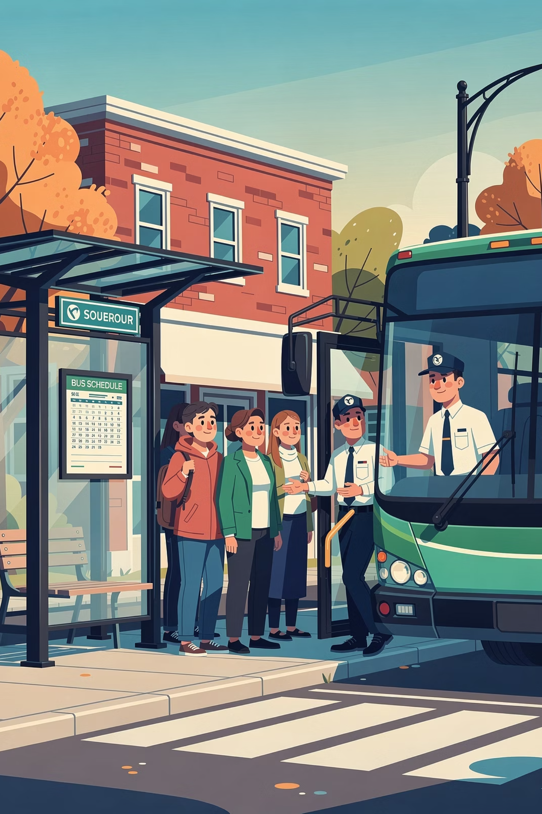
Our People
Investing in Drivers and Mechanics Means Reliable Service
Labor represents 73% of our budget — not an inefficiency, but a commitment. Competitive wages for drivers and mechanics ensure Old Orchard Beach residents can count on service to Portland, Biddeford, and beyond every day.
A well-staffed transit agency is a reliable one. Retention and recruitment investment today prevents service disruptions tomorrow.

Slide 12

Our People
Retention & Reliability: A Strategic Labor Investment
The FY 2027 budget reflects a deliberate commitment to workforce stability — not just a cost increase, but a strategy to protect service quality and maximize the return on our capital investments.
Market Alignment
The Cost of Vacancy
Total Labor Impact
Driver and support staff wages are budgeted at $1,337,798, reflecting current collective bargaining agreements (CBA) and market adjustments. Competitive pay is the foundation of a stable, professional workforce.
High turnover is expensive. Reliance on overtime and the loss of institutional knowledge costs more than competitive wages. Retention is the fiscally responsible choice.
Combined wages and benefits total $3,304,225. A stable workforce ensures that BSOOB's federal capital investments — including new electric buses — are operated by trained, experienced professionals.
Competitive wages today prevent service disruptions tomorrow — protecting both riders and the region's investment in modern transit infrastructure.

Slide 13

New Pricing Structure
A Fairer, Clearer Pricing Model for Campground Partners
Starting in FY 2027, BSOOB Transit implemented a new pricing matrix for Trolley service contracts. The new model accounts for two key factors — the size of the campground (number of sites) and the frequency of service — replacing the previous flat-rate approach with a structure that is more equitable and easier for partners to understand.
Campground Size
More Equitable
Tiered by number of sites: small (under 100 sites), medium (100–299 sites), and large (300+ sites).
Larger campgrounds with more frequent service pay proportionally more, while smaller partners pay less than before.
Service Frequency
Priced by how often the trolley serves the stop: standard, frequent, or premium frequency.
Easier to Understand
Partners can see exactly how their rate is calculated — no more opaque flat fees.
This pricing update was developed after an analysis found that some properties were paying vastly different fees for comparable service

Slide 14
Summary
Why This Budget Is the Right Investment
Trolley Service Leadership
Grant Leverage
The Old Orchard Beach Trolleys delivered 94,000 rides in FY 2026, making it one of Maine's top seasonal transit services.
Every local dollar unlocks nearly $3 in Federal and State support.
Fiscal Discipline
Equitable Partnerships
Near-balanced operations at $4.47M revenue vs. $4.5M in expenses.
A new pricing matrix ensures campground partners pay fairly based on size and service frequency.

Slide 15

FY 2027 · Old Orchard Beach Town Council
Thank You
We appreciate the Council's continued partnership and support. Old Orchard Beach's investment in BSOOB Transit is central to the region's seasonal economy — and every dollar Old Orchard Beach contributes is matched equally by Biddeford and Saco, tripling the regional impact before a single federal dollar is counted.
Old Orchard Beach's Ask
The Multiplier Effect
Questions?
Municipal Contribution: $352,800
Trolley Capital Cost: $0
Old Orchard Beach's $352,800 is matched by Biddeford and Saco — unlocking federal grants at a 9:1 ratio. Every dollar Old Orchard Beach invests generates $15 in regional economic activity (APTA, 2026).
We welcome any questions on the FY 2027 budget, the new trolley pricing structure, or campground partnership contracts.
⚠️ Important: By charter, all three member communities — Old Orchard Beach, Biddeford, and Saco — must contribute equally. A budget cut by Old Orchard Beach is not a one-to-one reduction: it triggers matching reductions from Biddeford and Saco, resulting in a three-fold loss to the transit system's operating capacity — including the Seasonal Trolley.

