Slide 1

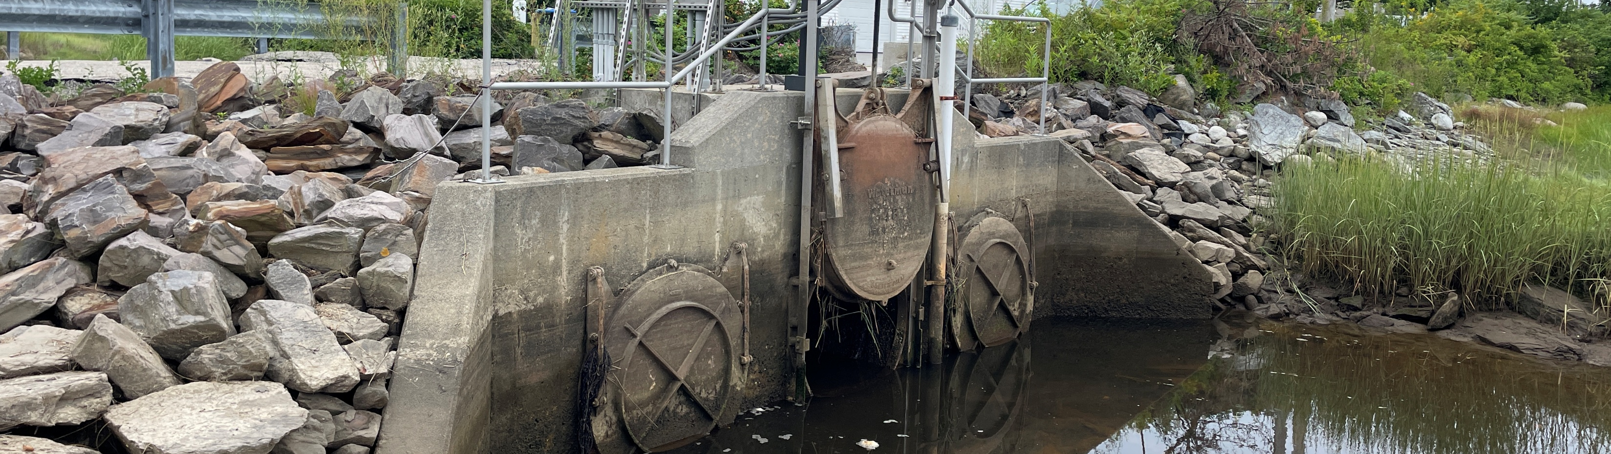
West Grand Marsh Resiliency Study
2025 Final Presentation
December 2025
Jaime Wallace, PE

Slide 2
Presentation Overview
Study Overview
Data Analysis
Public Input
Recommendations
Next Steps

Slide 3
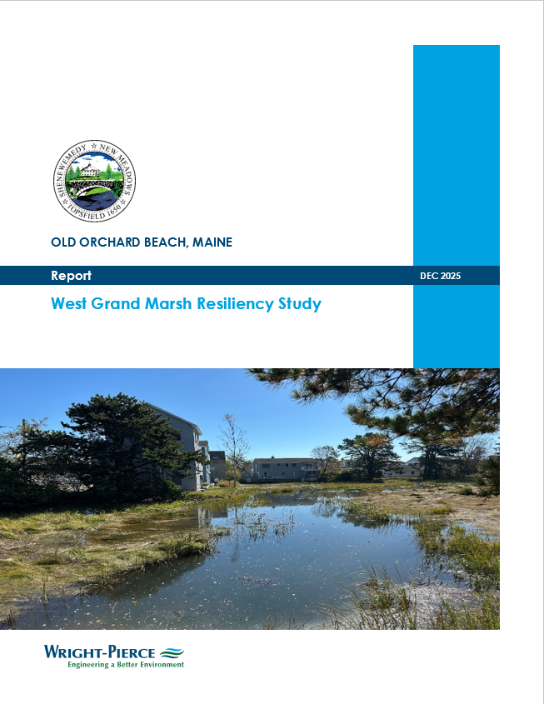
Study Overview
Data Collection Phase
LiDAR Drone Survey
FFE Survey
Tidal monitoring (May – June 2025 & October 2025 – Present)
Partnership with Stantec for Vegetation Assessment
Community Outreach
October 2025 Stakeholders Meeting
Public Comment Period (October – November 2025)
Public Hearing (December 2025)
Draft/Final Resiliency Study

Slide 4
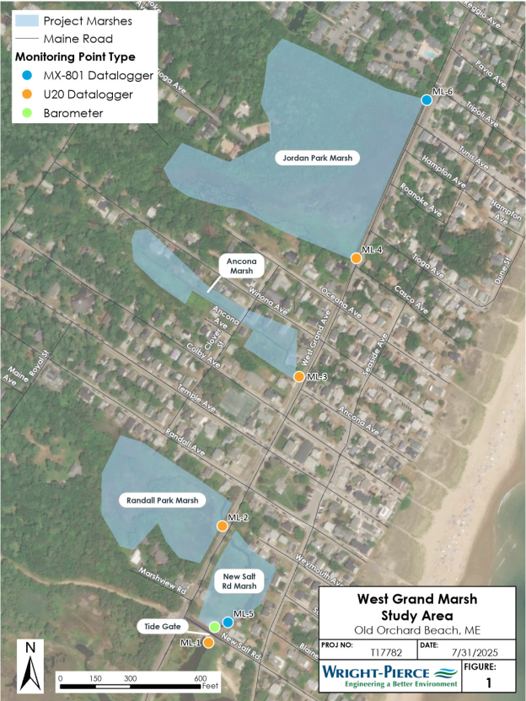
Data Analysis - Salinity Monitoring
0.35 ppt
31.0 ppt
30.7 ppt
30.4 ppt
31.2 ppt
30.4 ppt

Slide 5
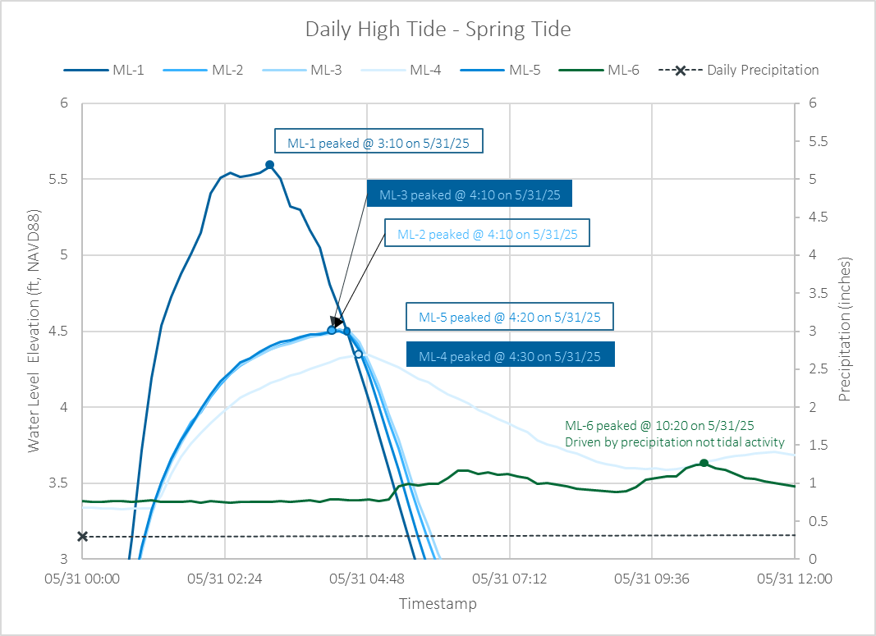
Data Analysis – Peak Water Elevations
General Observations:
As water level increases at ML-1, incremental peak difference in elevation from ML-1 to ML-5 increases.
No significant change in incremental peak difference across other ML’s.
Indicates that tide gate is biggest impediment of flows.
Additional Observations:
ML-4 is not influenced by tidal activity until water level at ML-1 surpasses ~3.5-feet.
In general, water elevation peaks at ML-6 are influenced by precip. events.
Potential outside influence on ML-3 showing peaks higher than ML-1

Slide 6
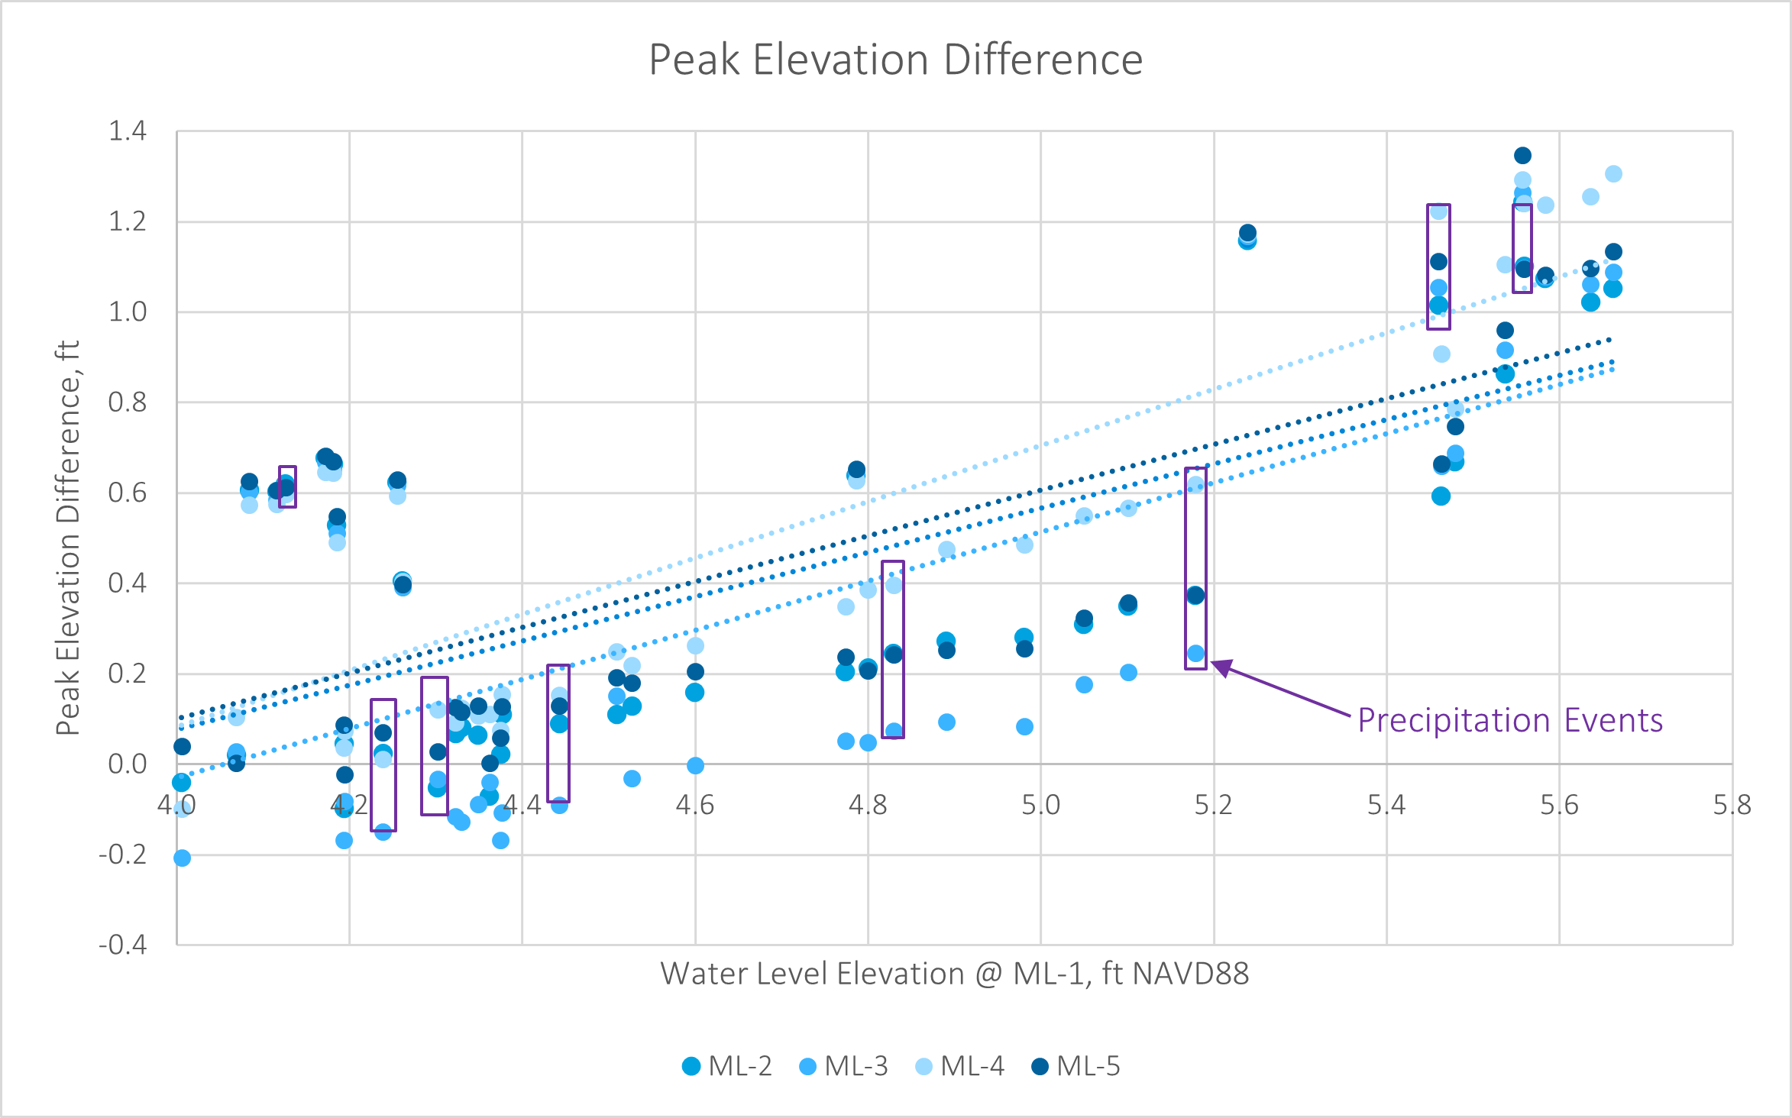
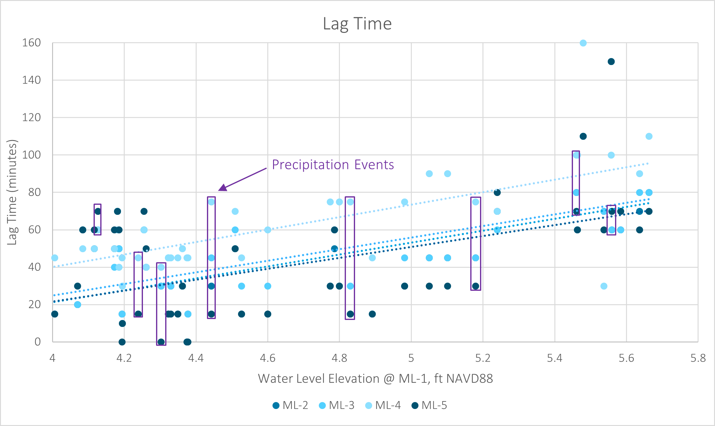
Data Analysis – Peak Water Elevations & Lag Time

Slide 7
Public Input
Community Outreach Responses
Comment Category | General Comments | Recommendations
Sediment in the System | Too much sediment built up in system Dredging downstream of tide gate (outside scope) | Dredging will likely cause more harm than good. Regulatory hurdles. Town on list for York County dredge.
Operation and Maintenance | Ensure a smooth and ongoing operation of SRT. Identify responsibilities for gate operation. | Iterative process for updating SRT SOP. Wastewater department currently responsible for operation.
Continued Monitoring | Continue utilizing Town owned data loggers. Suggest developing strategic partnerships. | Partnership opportunities with UNE and adjacent communities. Expand monitoring locations within the system.

Slide 8
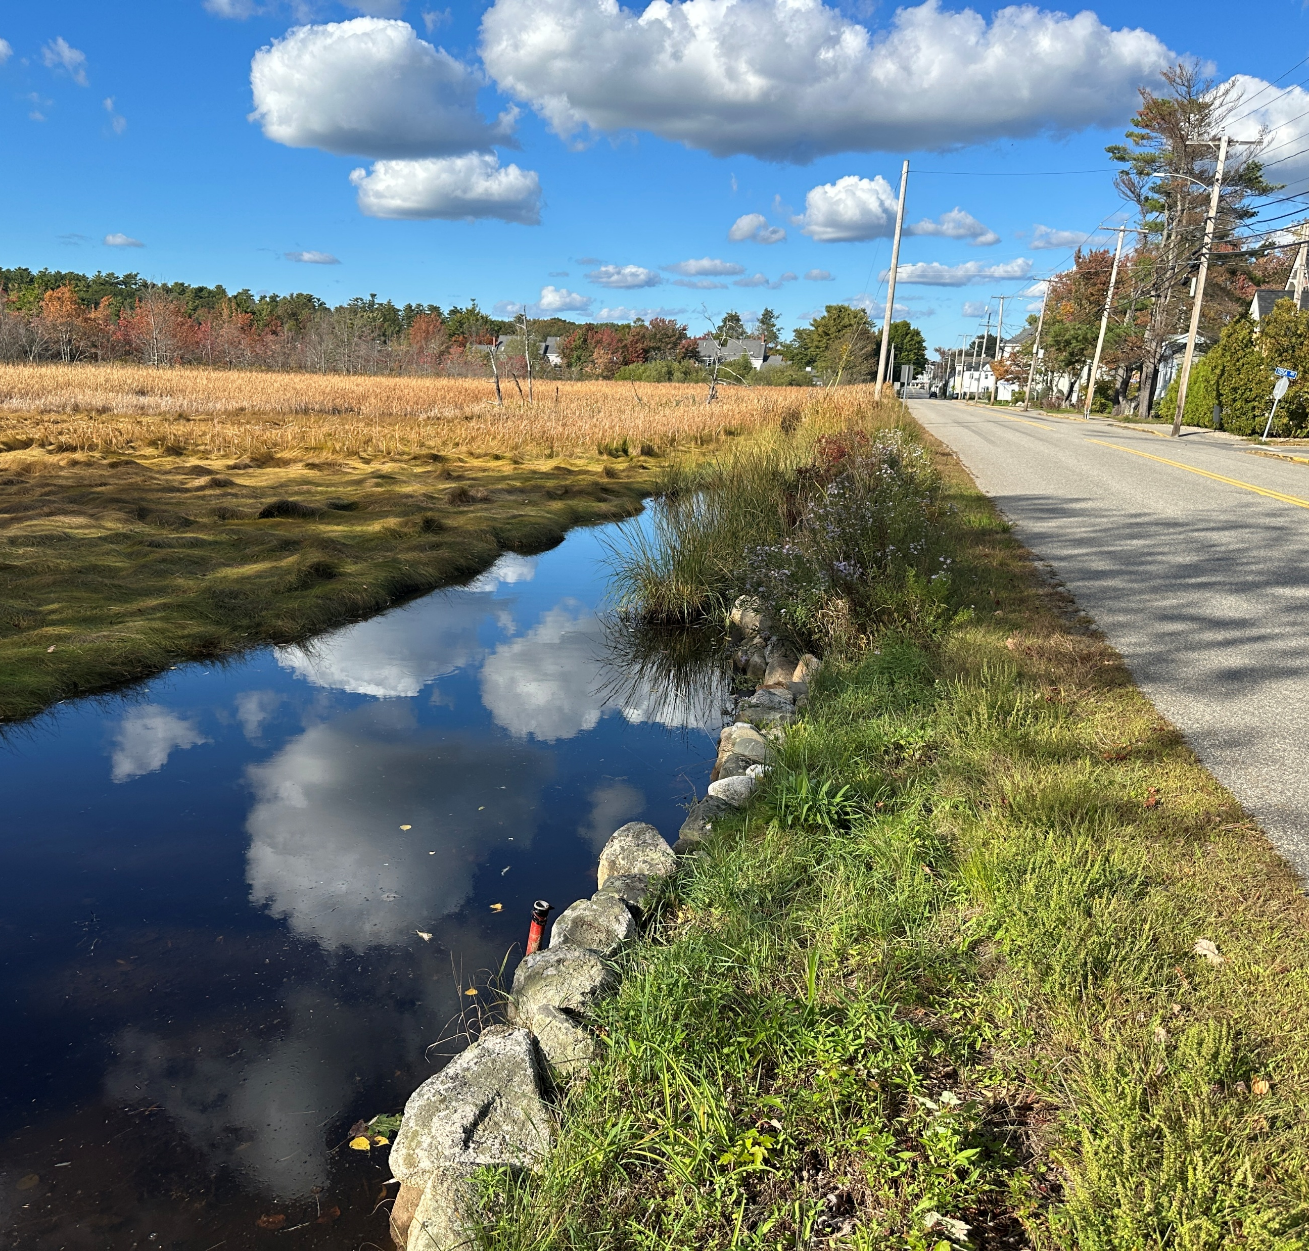
Recommendations
Continued Monitoring
Implement adjustments in SRT protocol
Consider additional actuating gates.
Routine maintenance and structure cleaning.
Stormwater improvements
Future Considerations/CIP Projects:
Raise low-lying roads adjacent to marshes
Evaluate/replace existing culverts as needed.
Raise private infrastructure adjacent to marshes.
Consider ordinance changes for FFE’s

Slide 9
Next Steps
Implement Revised Gate Operations
Iterative adjustment
Field observations
Marsh health monitoring
Cont./Expand Marsh Monitoring
Maintain current loggers
Deploy additional loggers
Consider developing partnerships
Develop Structure Maintenance Schedule
Develop a structure maintenance plan.
Coordinate with DPW
Assess Funding Opportunities
Review state and federal funding programs.
Programs may fund additional studies and upgrades
Community and Stakeholder Engagement
Maintain communication with residents.
Provide updates on monitoring results & CIP’s
No “one size fits all” approach. Very complex system.

