Slide 1
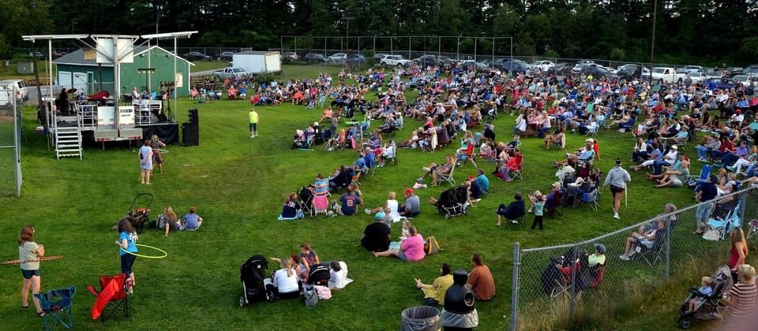
Old Orchard Beach Recreational Complex at the Ball Park
WWW.OOBMaine
Contact
Jason Webber
Recreation & Event Director Cell 207-423-2044
Jwebber@oobmaine.com Frank Perez
Special Event Coordinator Cell: 305-979-7446
fperez@oobmaine.com
Old Orchard Beach Recreation & Ball Park
Sponsorship Opportunities 2022
Address
7 Ball Park Way, Old Orchard Beach, ME
04064

Slide 2
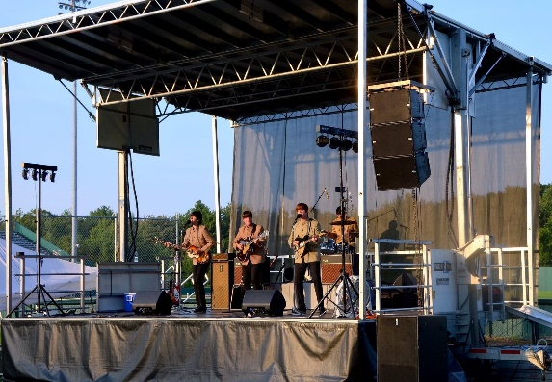
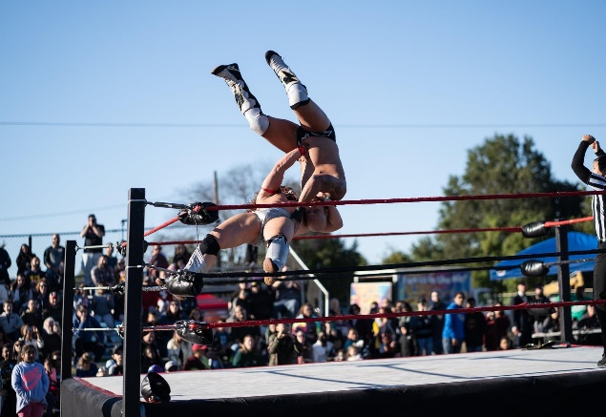
Dear Prospective Sponsor:
Cover Letter
The Town of Old Orchard Beach Recreation Department sponsorship program is designed to effectively market local businesses while positively impacting our community. Unlike other traditional forms of advertising, our sponsorships allow a company to be associated with the positive benefits of a community event or recreational program. Whatever your marketing needs, we have different partnership opportunities to complement your plan.
The Recreational Complex at The Ball Park is a community gem that attracts visitors from all over and provides our residents with a greater quality of life. With the help of our sponsors, we can offer more quality programs and facilities to the residents of OOB and the surrounding communities. Your sponsorship plays a vital role in shaping our lives, families, and home. Much of our residents' enjoyment and lasting memories depend on the programs and facilities offered. By becoming a sponsor and showing your support of our programs and events, you show your support for the community. This will, in turn, make a positive impact on your business.
Jason Webber
Recreation & Event Director
Frank Prez
Special Event Coordinator
We hope this comprehensive sponsor packet will provide you with detailed information about the available events and opportunities. Please take some time to review each event and the offered exposure. I would be happy to meet with you to discuss these opportunities in detail and answer any questions.
Date and Vanue
Recreation Complex and entertainment Center at The Ball Park
Events Throughout the Year
2
www.OOBRec.com

Slide 3
2022 Concerts at the Ball Park
2022 Dates: July 7 – Aug 25 (Thursday Nights) 6:30 – 8:00pm at the Ball Park, in OOB
Our 2021 Season had over 10,000 attendees singing & Dancing along to
some of the best cover bands in New England.
Event
Presenting Sponsor
(1 Only)
Concert Sponsor
(8 Only)
Lawn Supporter
Listed in a paid press release of all sponors in the local paper.
Listed on our social media (Facebook, Instagram and Tic Tok)
Corporate Name, Logo and listed on OOB Recreation website & Sponsorship Banner.
Promo Table provide at All 8 Concerts: (sponsor provides own tent)
Corporate banner on the front of the Stage
Large Logo on all promotional flyer and Posters.
Emcee acknowledgement at all 8 concerts
Two mentions on our social media (Facebook, instagram and Tic Tok)
Corporate Name, Logo and link on OOB Recreation website & Sponsorship Banner.
Reserved seating & party with food for your company at the concert of your choice. (Max 10 people)
Promo Table provide at sponsored concert (sponsor provides own tent)
Corporate banner on event grounds
Logo on all promotional flyer and Posters.
Emcee acknowledgement at sponsored concerts.
Once mention on our social media (Facebook, Instagram and Tic Tok)
Corporate Name, Logo and listed on OOB Recreation website & Sponsorship Banner.
$500
Friends of the Ballpark
Help support local music and the arts
Listed in a paid press release of all sponors in the local paper.
$5,000
$1,500
$50
Www.OOBRec.com
3

Slide 4
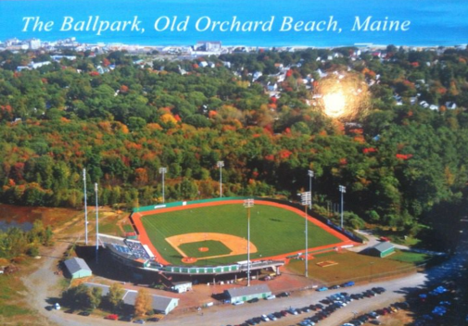
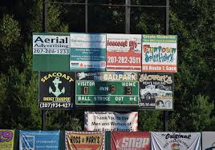
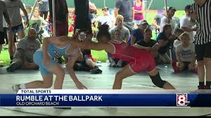
Stadium Field Signs
About
Join the winning team of sponsors helping to support the Old Orchard Beach Ballpark Stadium and promote your business or organization to thousands of fans throughout the 2022 season.
Join our team in helping the Old Orchard Beach Ballpark and Stadium succeed and continue to grow in 2022. With a stadium that boasts a seating capacity of 5,500, the Ballpark can help promote your business or organization to the thousands of Baseball Fans and Event visitors throughout the season. Your ad will get Outstanding exposure and show the citizens of New England that you are giving back to the community.
Outfield Wall 8 x20’: $2,000
Top Half Scoreboard 6 x 10’: $1,500
Either Side of the Scoreboard 7 X 7: $1,500
Full Dugout Roof Cover: $3,000
Staduim Seat Cover 36 x 33: $5,000 (Covers 2 year; Only 4 spots)
Over 200
AAU, High school, College and Adult Baseball Games
20
Major Events, Tournaments and concerts.
20,000+
Attendees
www.yourwebsite.com
4

Slide 5
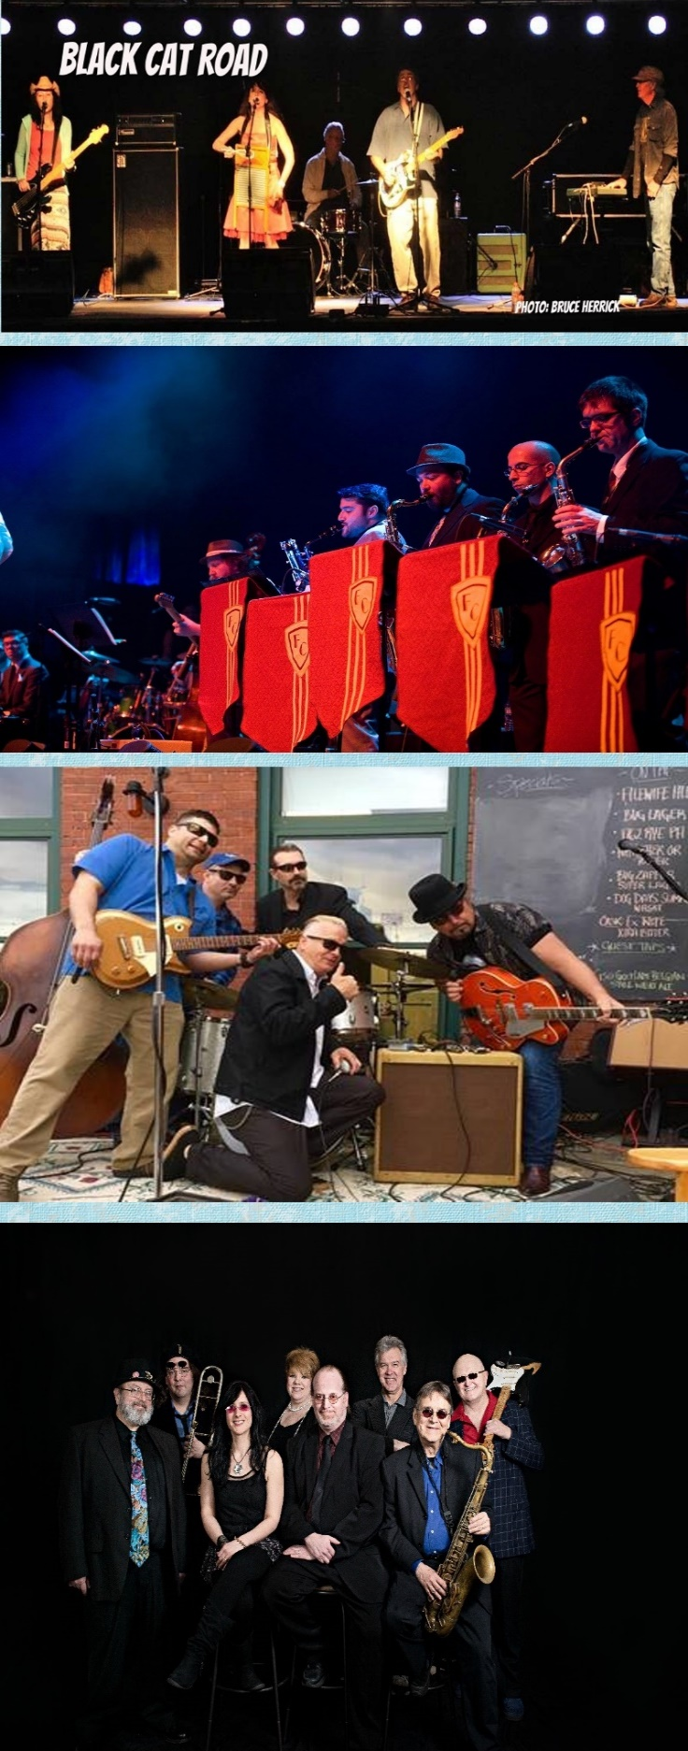
2022 Annual Blues & Jazz Festival
August 13, 2022
Fogcutters
Juke Joint Devils
Black Cat Road
Pat Colwell and the Soul Sensations
Become a Proud Sponsor
Platnum Sponsorship – One Available $2,000
Sponsorship Banner 3 x 8 Front of the stage
6 X 6 Banner at Gate
50 Event Tickets
Name announced by MC every hour
Name on Sponsor Banner
Gold Sponsorship – Two available $1,000
3 x 4 Banner on front stage
4 x 4 Banner on Gate
25 Event Tickets and on Sponsor Banner
Silver Sponsorship – six available $500
4 x 4 Banner on Gate
20 Event Tickets and on Sponsor Banner
Bronze Sponsorship – unlimited $250
10 Event Tickets
Name on Sponsor Banner
5

Slide 6
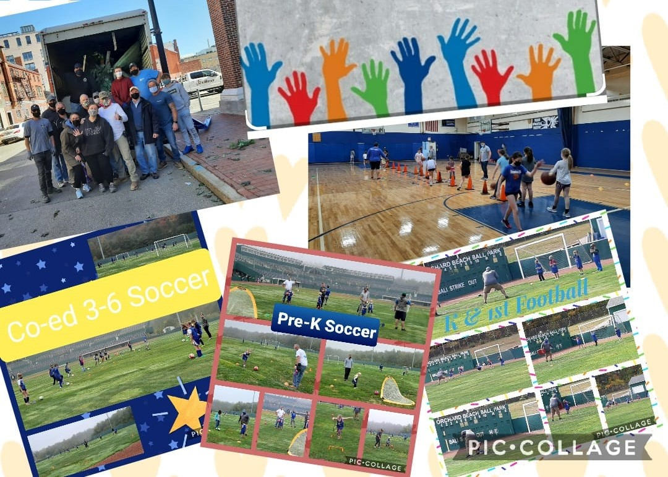
Recreation Youth Sports Programs
Fall Youth Sports (1 Available)
Company Name / Logo Printed on marketing materials. (Includes posters, flyers & t-shirts) 100+ Participants
Company Linked to OOB Recreation website for 45 days.
Opportunity to distribute promotional materials.
Banner Hung at all Clinics
Winter Youth Sports (1 Available)
Company Name / Logo Printed on marketing materials. (Includes posters, flyers & t-shirts) 100+ Participants
Company Linked to OOB Recreation website for 45 days.
Opportunity to distribute promotional materials.
Banner Hung at all Clinics
$500
$500
Clinic Sponsor ( 8 Available)
Banner company Logo Hung at all clinics for both Fall and Winter.
Opportunity to distribute promotional materials.
$150
6
www.yourwebsite.com

Slide 7
50+ Senior Programs
Business ad: Quarter Page (4 Available)
Company Name / Logo Printed on quarterly 50 plus senior newsletter. (Both printed and dit
Company Linked to OOB Recreation website
Mention on social media (Facebook, Instagram)
$300
Life of the Party – St Patrick Day Party ( 1 Available)
Company Banner at Event and Flier
Opportunity to distribute promotional materials at event.
Company Linked to OOB Recreation website
$500
Lunch and Learn Speaker (1 Available)
Company Banner at Event and Flier
Opportunity to distribute promotional materials at event.
Company Linked to OOB Recreation website
$500
7
www.yourwebsite.com

Slide 8
In the Park
Sliver Screen
Presenting Sponsor (One Available)
Large Company Name / Logo printing on event marketing materials.
Recognition in event script
Promo Table provide for all 4 concerts. (Encourage you to have an organized activity to add appeal to your movie nights
Company linked on the OOB Recreation website for entire movie season.
Company banner displayed each movie night
Reserved seating and party with food for your company at the movie night of your choice. (max 10 people)
Silver Screen in the Park
It is OOB Recreation's newest community event at The Ball Park. Like our other events, it will attract hundreds of people each night and soon be one of the popular summer traditions for families. Families come out for an evening of free fun and activities before watching a movie on the inflatable movie screen.
Package Value
$1500
Single Night Sponsor –
(1 Available on each date)
Tuesday Nights:
July 12, 26 August 2, 16
8:30pm – Movies start at dusk
Recreational Complex at the Ball Park entertainment Hill
Anticipating about 500 each night
Company Name/Logo printing on event marketing materials.
Recognition in event script
Company linked on the OOB Recreation website for 2 weeks.
Company banner displayed on the movie night you sponsored.
Promo Table provide on night you sponsored. (Encourage you to have an organized activity to add appeal to your movie nights)
8
Package Value
$500

Slide 9
(For donations of cash, in-kind services, gifts & giveaways)
Custom Package Sponsorships: We are open to your suggestions and look forward to discussing creative options. Custom Package Sponsor benefits will be negotiated and matched with benefits at the sponsorship levels described. You can bundle event sponsorships and ball field/scoreboard signage to get a bigger band for your buck!
Sponsorship Opportunities
In-Kind Sponsorships:
Consist of a donation of a certain product or service instaead of direct financial contribution. For example, a restaurant may provide food for an event, help provide print and advertisement in exchange for being recognized as sponsor. There are numerous possibilities. The “market value” of the contribution must meet or exceed
a specific amount to be considered a
sponsor for an event program
Scholarship Program:
It is the policy for the Old Orchard Beach Recreation Department to provide recreational opportunities to all residents of OOB. Programs listed below require the payment of fees to cover the expenses. Realizing the need to include all residents we offer financial assistance to OOB residents meeting guidelines we have established. A contribution will insure additional space for more scholarships be offered.
$5000
OOBMaine.com
9

Slide 10
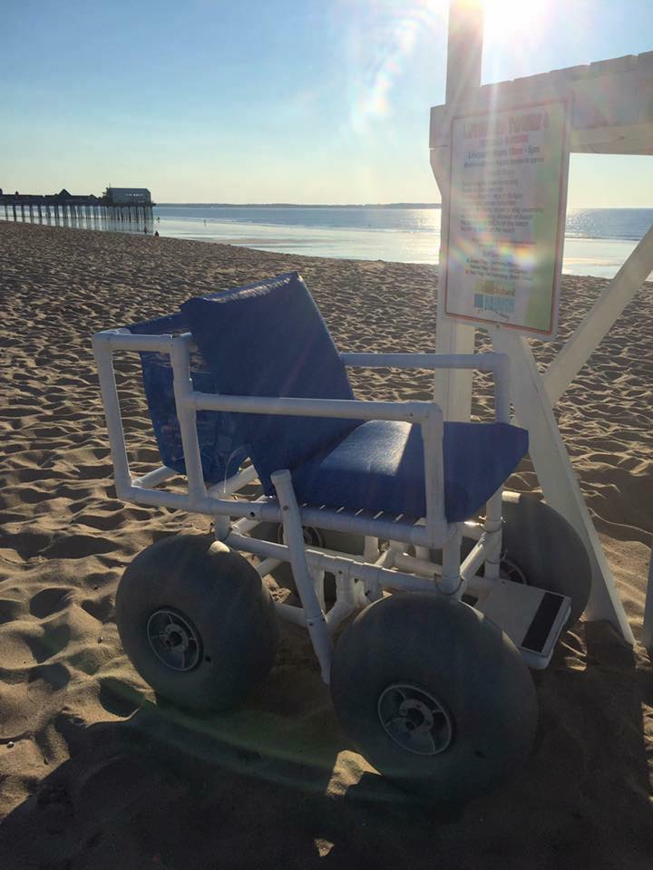
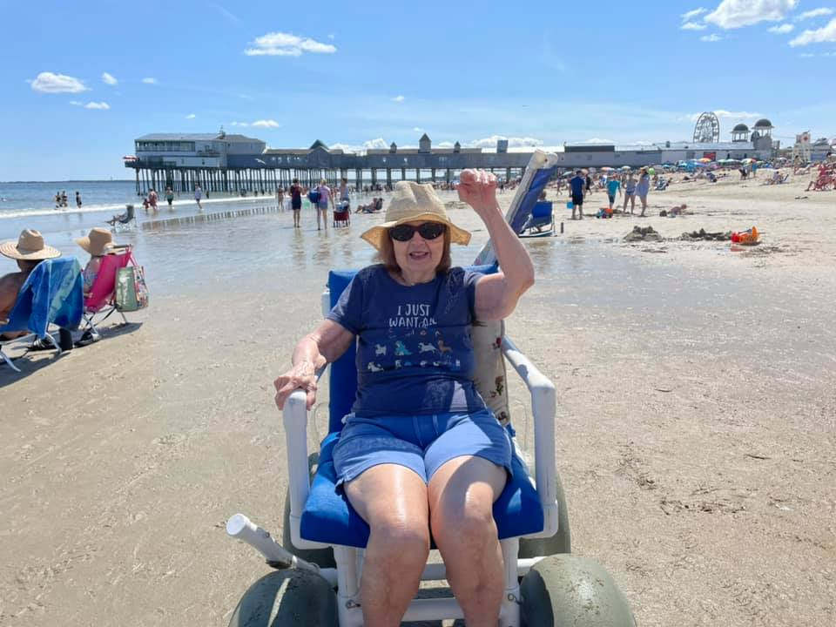
#AccessOOB
Beach Wheel Chair Program
It started with a letter and now is one of the most rewarding programs we offer. Access to our beach should be easy for everyone. Our Beach Wheelchair is housed at a few hotels that line our beach. We also have three that are used in the long-term rental.
This is free for rental for anyone that comes to visit our community. Your Banner will be on the back of the wheelchair.
$1,800
$5000
WWW.OOBRec.com
9

Slide 11
Town of Old Orchard Beach
1 Portland Ave
Old Orchard Beach, ME
04064, ME
207 – 423- 2044
Jwebber@OOBMaine.com
www.oobmaine.com

